Slide 1
Lecture 4: Alternative Model Structures
April 16, 2020

Slide 2
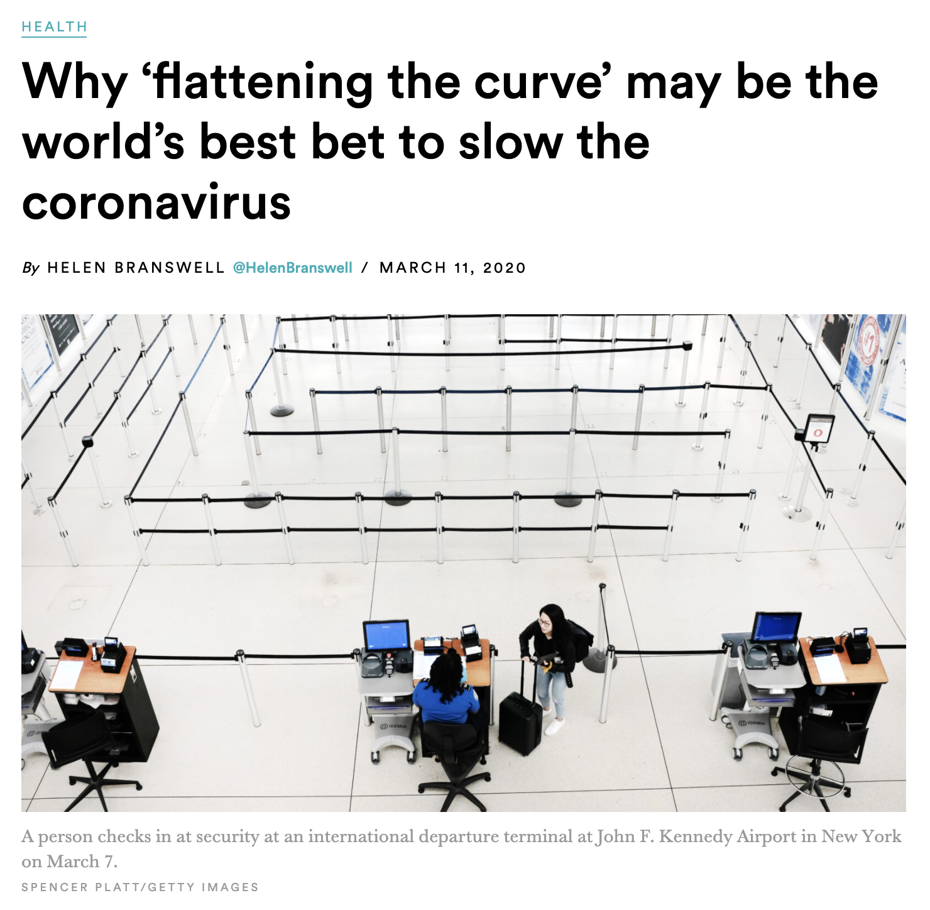
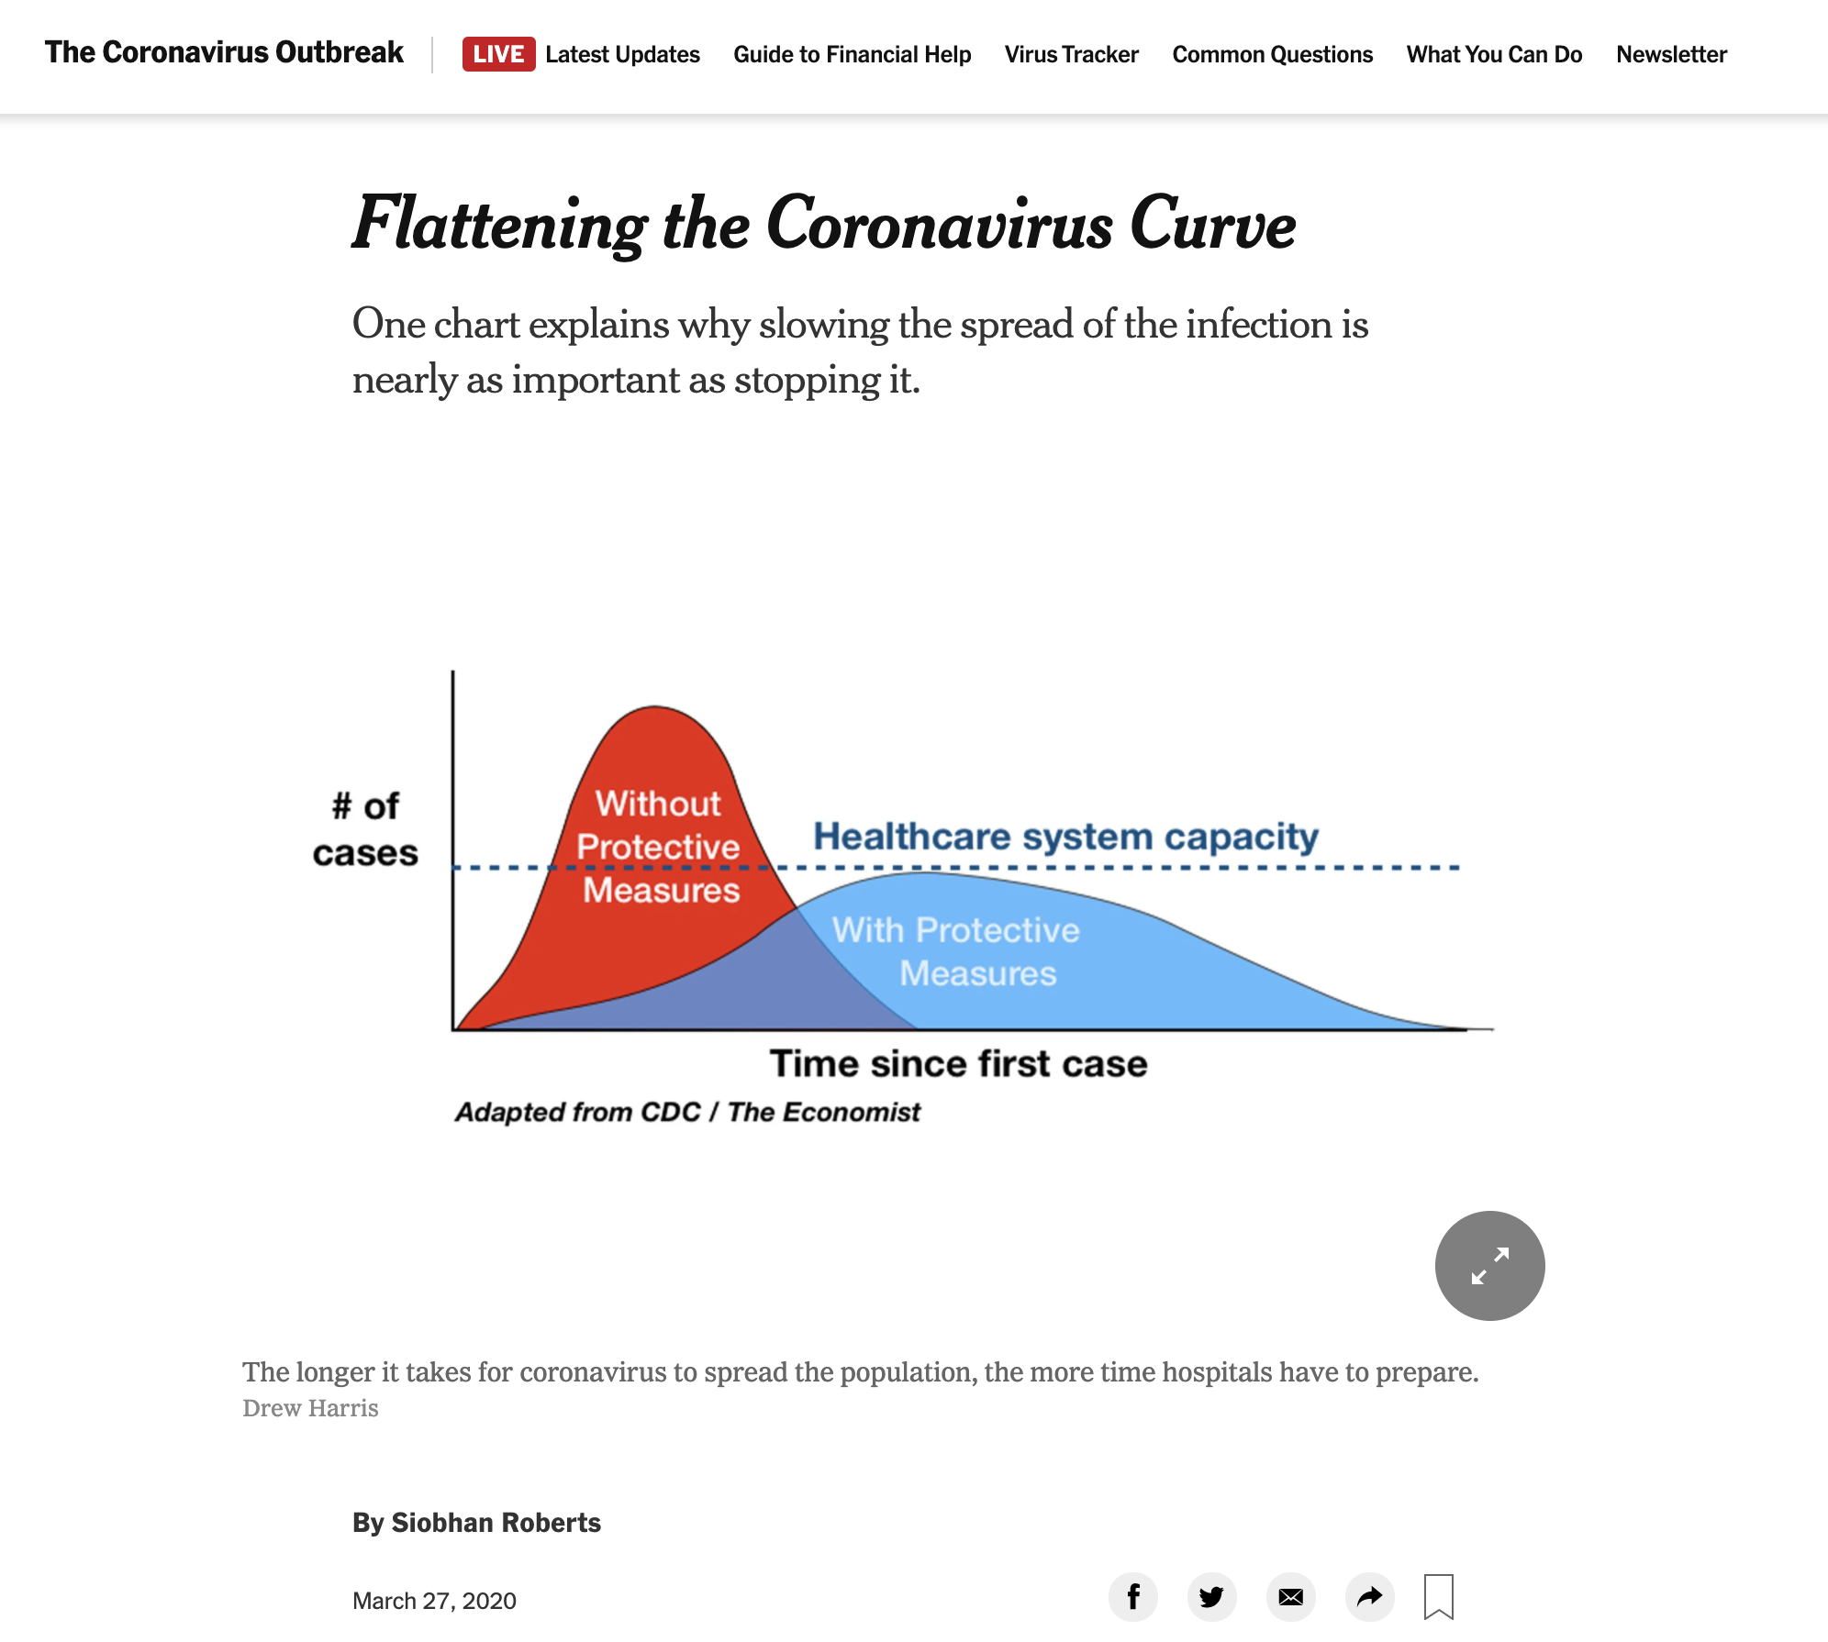
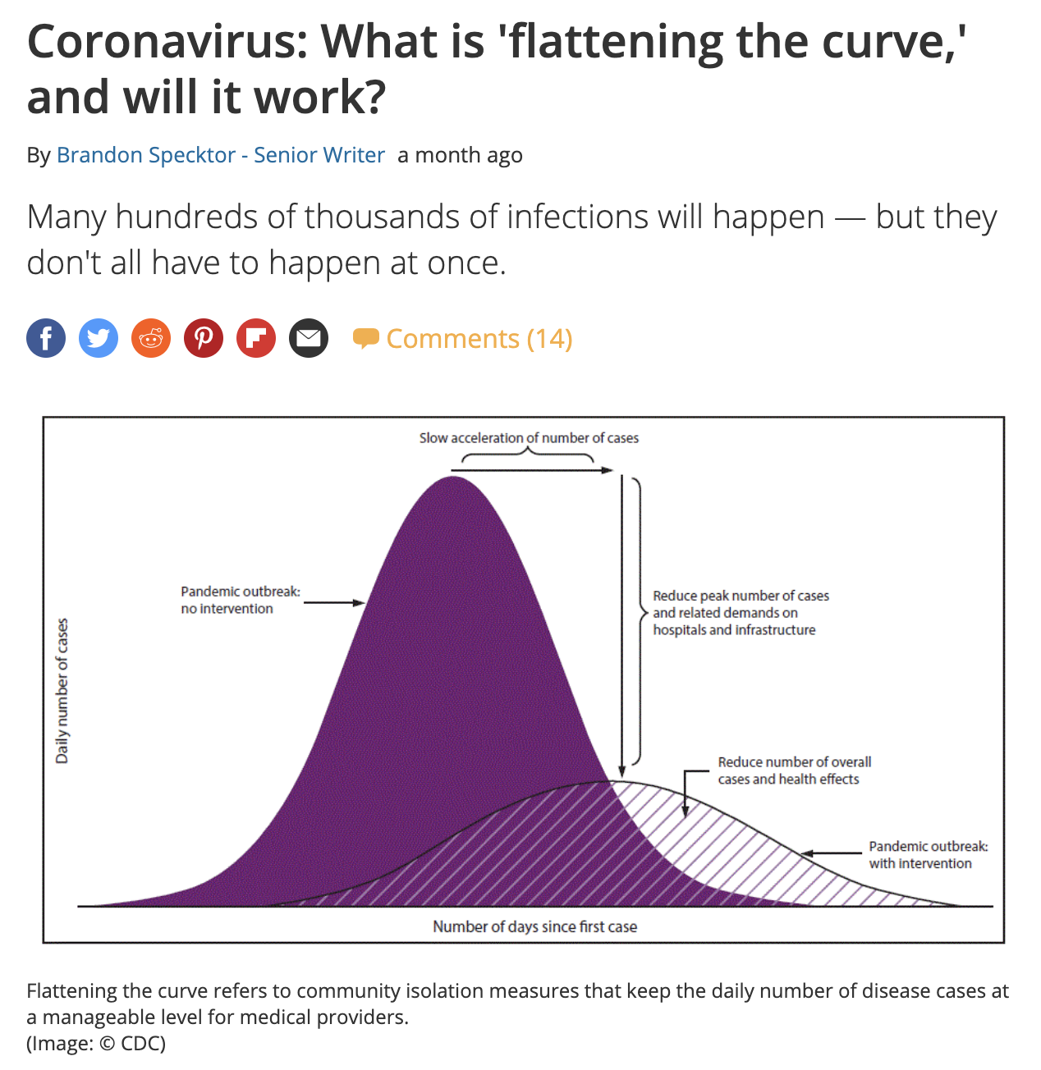
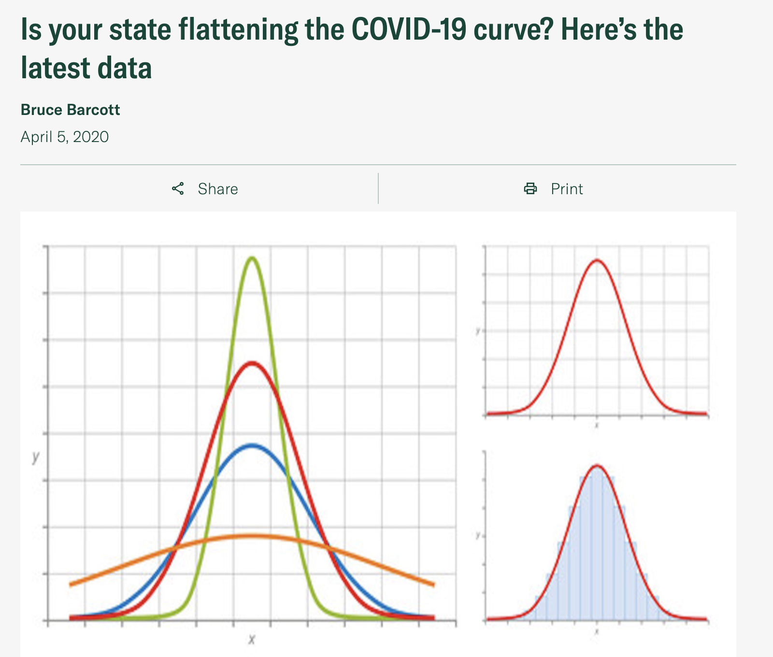
“Flattening the Curve”

Slide 3
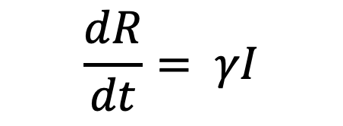

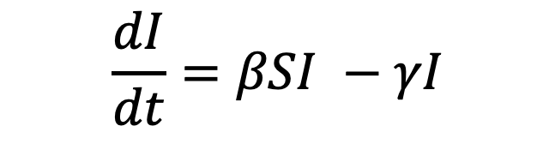
SIR Model
S
βSI
I
γΙ
R
infection
recovery
$$\frac{dS}{dt}=−βSI$$
Which component of the model do our physical distancing interventions target?
$$\frac{dI}{dt}=βSI −γI$$
$$\frac{dR}{dt}= γI$$

Slide 4
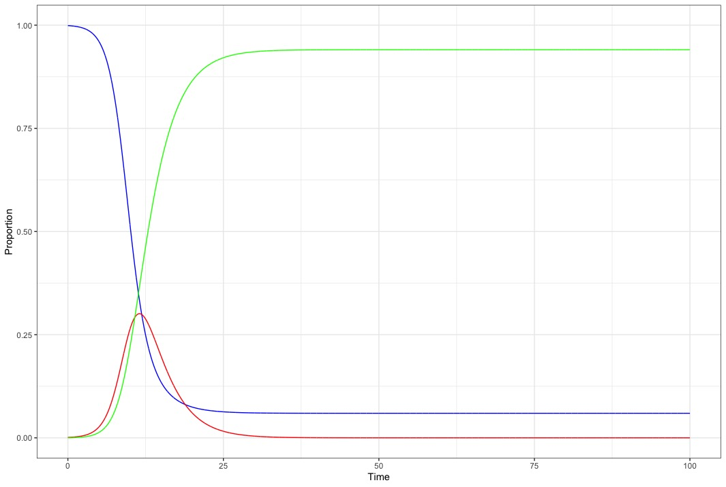

$$β=1/day$$
$$γ=\frac{1}{3 days}$$
$$R_{0}=3$$

Slide 5
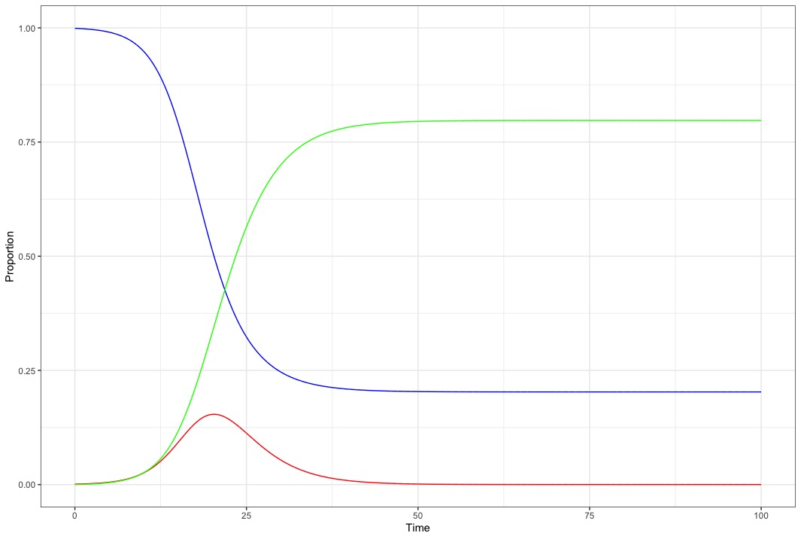
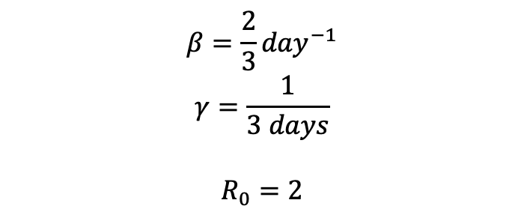
$$β=\frac{2}{3}{day}^{−1}$$
$$γ=\frac{1}{3 days}$$
$$R_{0}=2$$

Slide 6
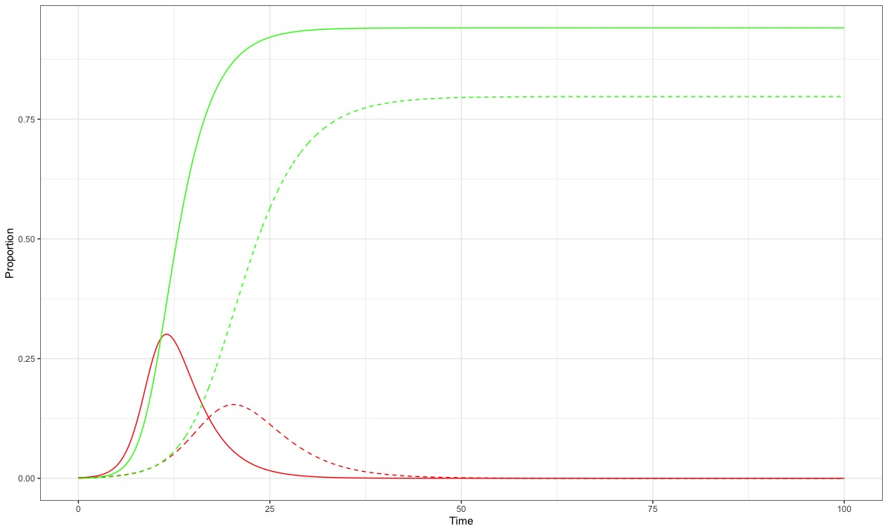
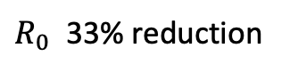
Without intervention
15% relative reduction
With intervention
$R_{0}$ 33% reduction

Slide 7
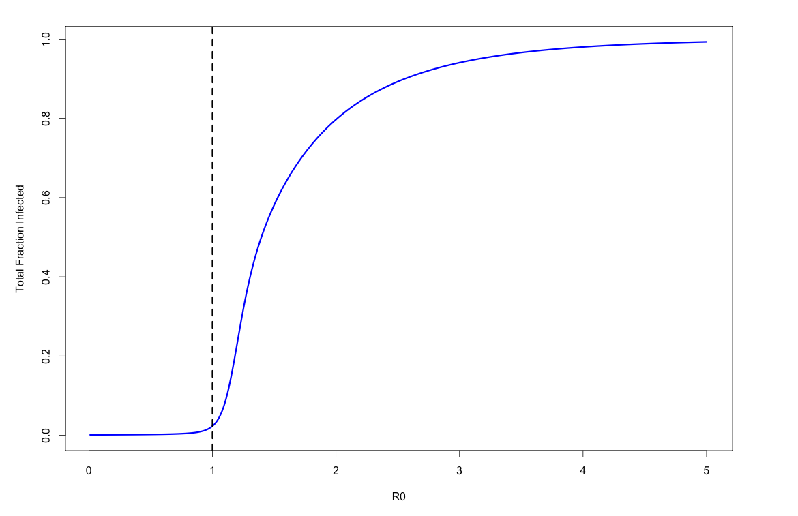

Slide 8
Without intervention
15% relative reduction
With intervention
$R_{0}$ 33% reduction
50% relative reduction

Slide 9
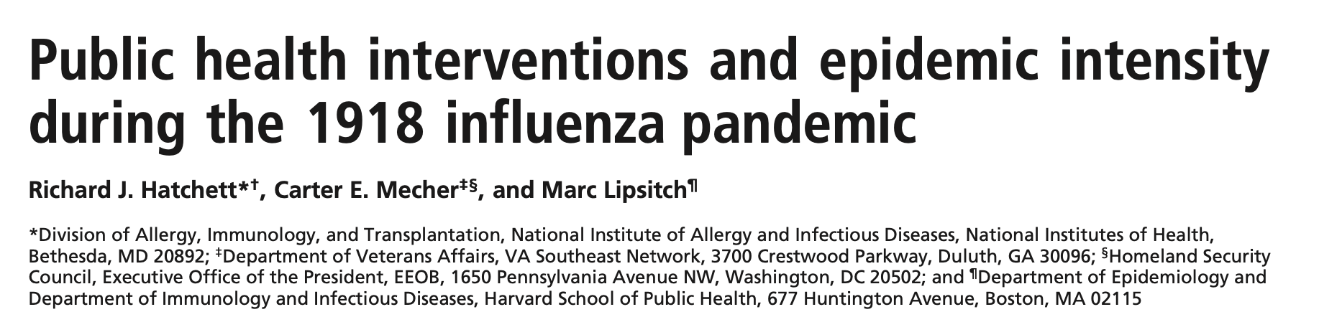
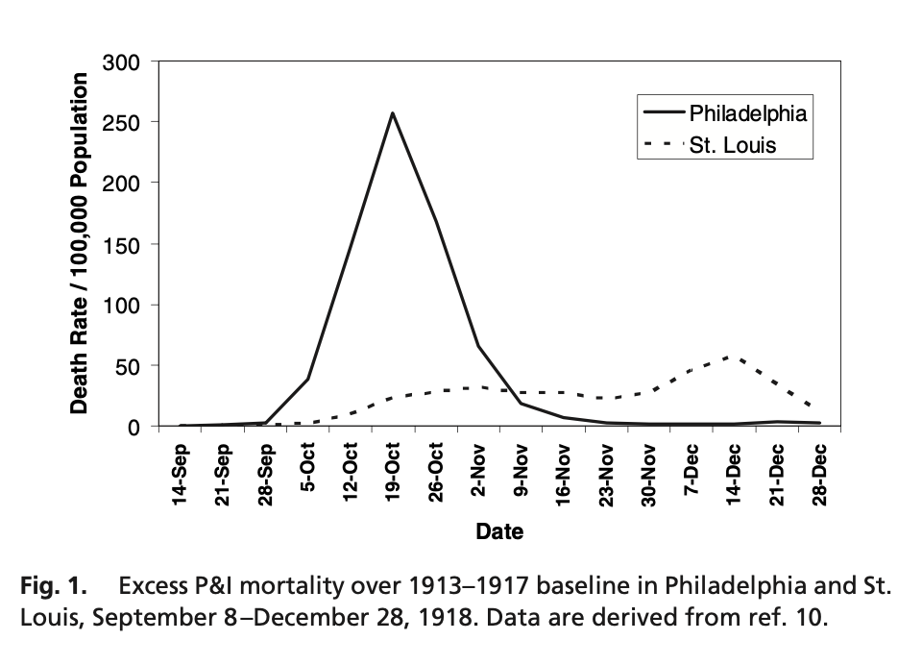
Philadelphia
First case: Sept 17
City-wide parade Sept 28
Social distancing began Oct 3
(17 days)
St. Louis
First Case: Oct 5
Social distancing: Oct 7
(2 days)
Peak Death Rate
257 / 100,000
Cumulative Excess Death Rate
719/100,000
Peak Death Rate
31 / 100,000
Cumulative Excess Death Rate
347/100,000

Slide 10
Learning Objectives
Understand key components of the natural history and transmission of infectious diseases, including incubation period, latent period, infectious period and serial interval
Describe approaches to characterizing these intervals
Understand the differences in behavior of SIR and SEIR models, and when SEIR models may be preferred
Identify limitations to the common ODE formulation of SIR/SEIR models

Slide 11
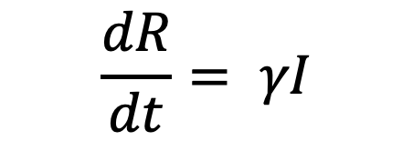

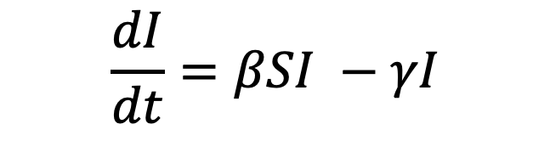
SIR Model
S
βSI
I
γΙ
R
infection
recovery
$$\frac{dS}{dt}=−βSI$$
$$\frac{dI}{dt}=βSI −γI$$
$$\frac{dR}{dt}= γI$$

Slide 12
Natural History and Transmission Intervals
Individuals are almost never symptomatic or infectious immediately after being infected
There are “incubation” and “latent” periods
SIR model ignores these states

Slide 13
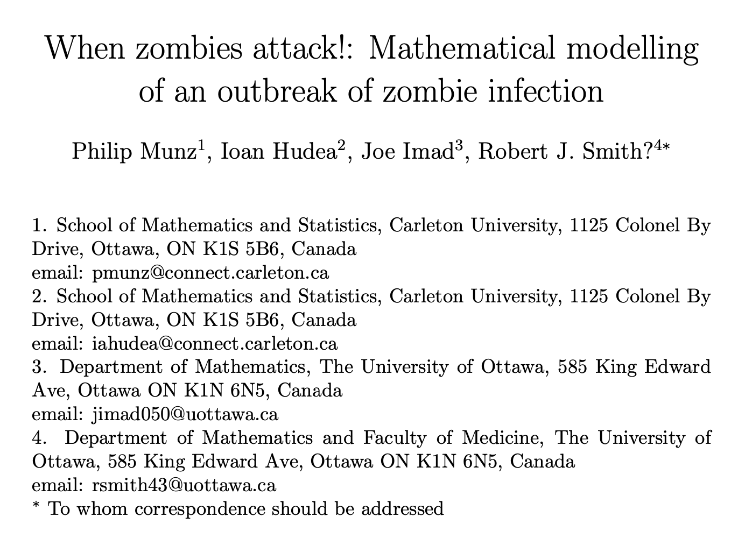
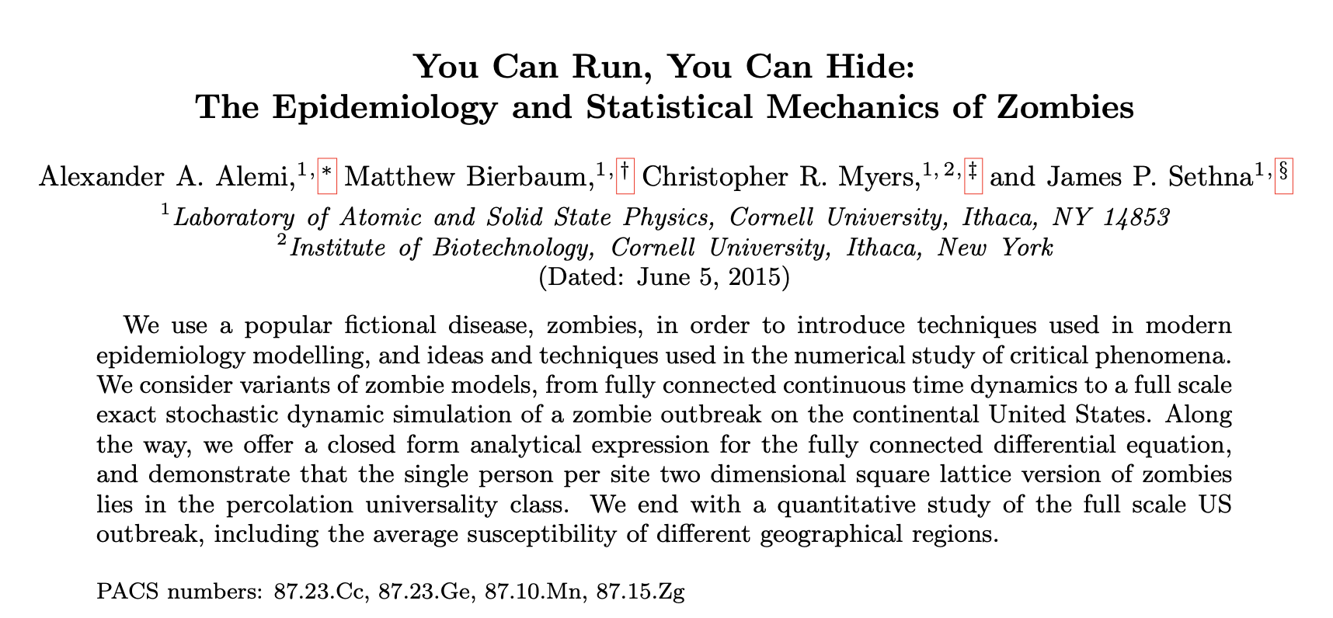
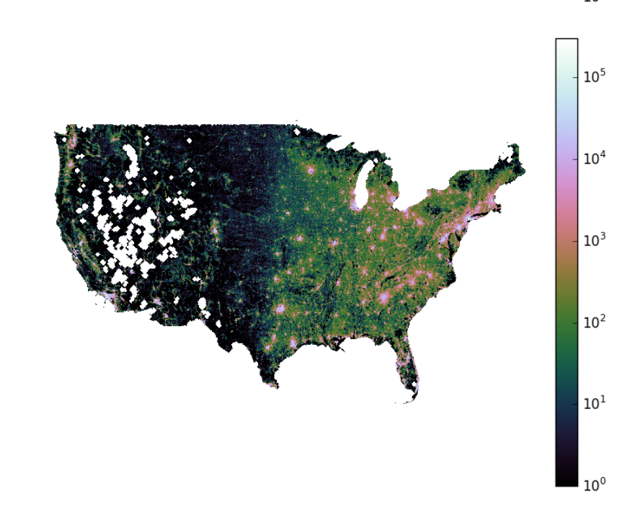
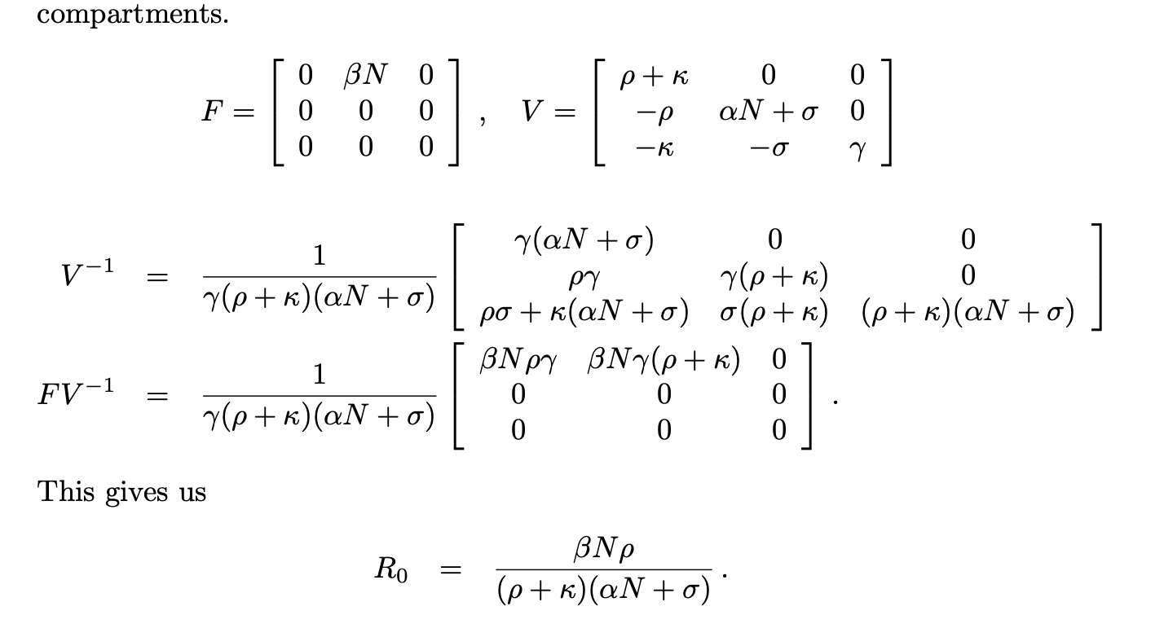
Models with short latent periods
S
βSZ
Z
γΖ
R
infection
removal

Slide 14
Natural History and Transmission Intervals
Symptom onset
Infection
Incubation Period
Symptomatic Period
Natural history

Slide 15
Natural History and Transmission Intervals
Symptom onset
Infection
Incubation Period
Symptomatic Period
Natural history
Latent Period
Infectious Period
Transmission
Infectiousness onset

Slide 16
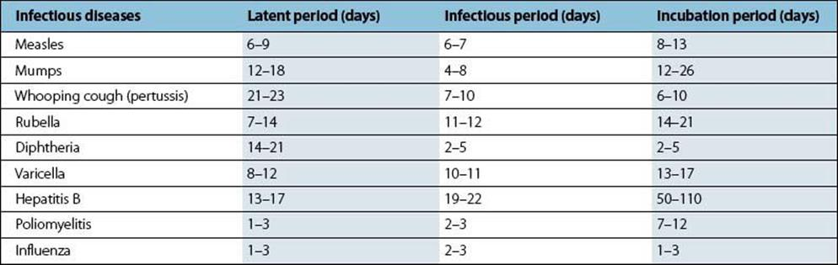
Natural History and Transmission Intervals
http://schoolbag.info/biology/microbiology/33.html
How do we measure these?

Slide 17
How do we measure these intervals?
Difficult with recurrent, household exposures
Take advantage of specific, single event exposures of a known time and character

Slide 18
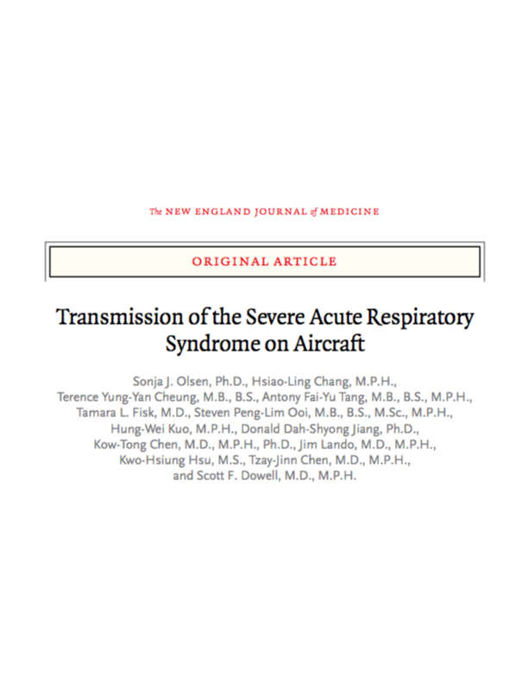
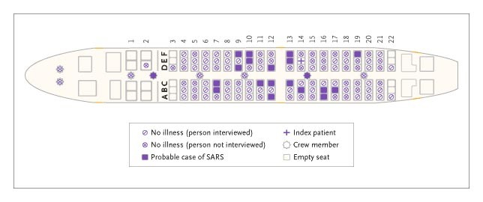
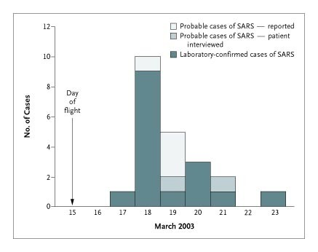
3-hour flight from Hong Kong to Beijing
Index case was symptomatic man 4 days into illness
22 people probable secondary cases

Slide 19

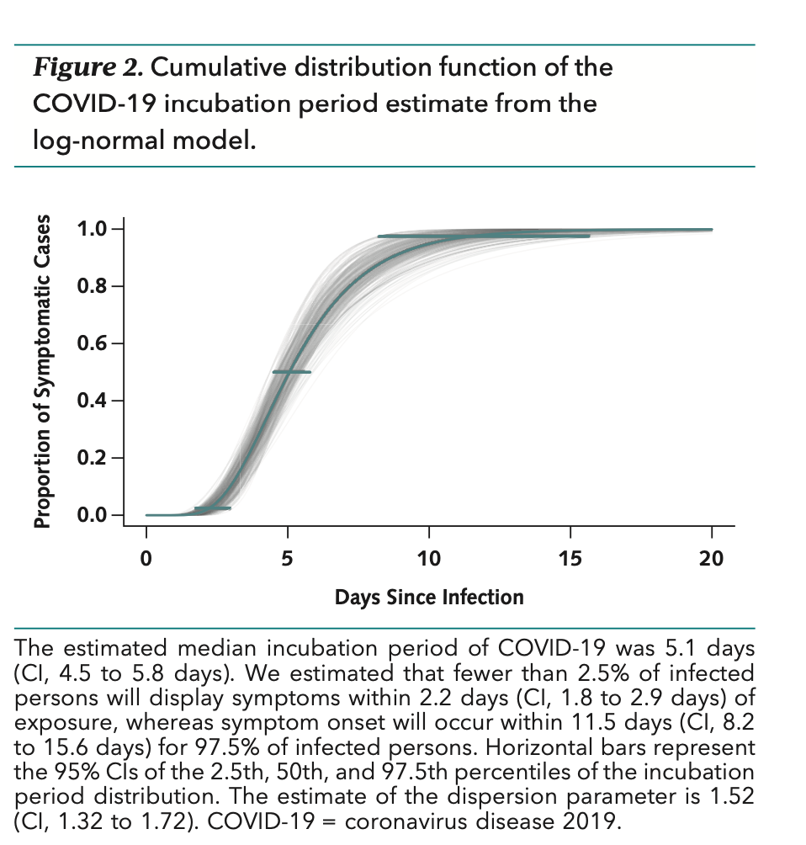
181 cases with identifiable exposure and symptom onset windows

Slide 20
Incubation Periods and Serial Intervals
Clinical Onset Serial Interval
Incubation Period
Symptomatic Period
A
Latent Period
Infectious Period
Transmission
Incubation Period
Symptomatic Period
B
Latent Period
Infectious Period
Transmission Interval
Fine PEM, Am J Epi, 2003

Slide 21
Incubation Periods and Serial Intervals
Clinical Onset Serial Interval
Incubation Period
Symptomatic Period
A
Latent Period
Infectious Period
Transmission
Incubation Period
Symptomatic Period
B
Latent Period
Infectious Period
Fine PEM, Am J Epi, 2003

Slide 22
Evolutionary Perspective on Serial Intervals
From pathogen perspective, what are advantages to a short serial interval?
To a long serial interval?

Slide 23

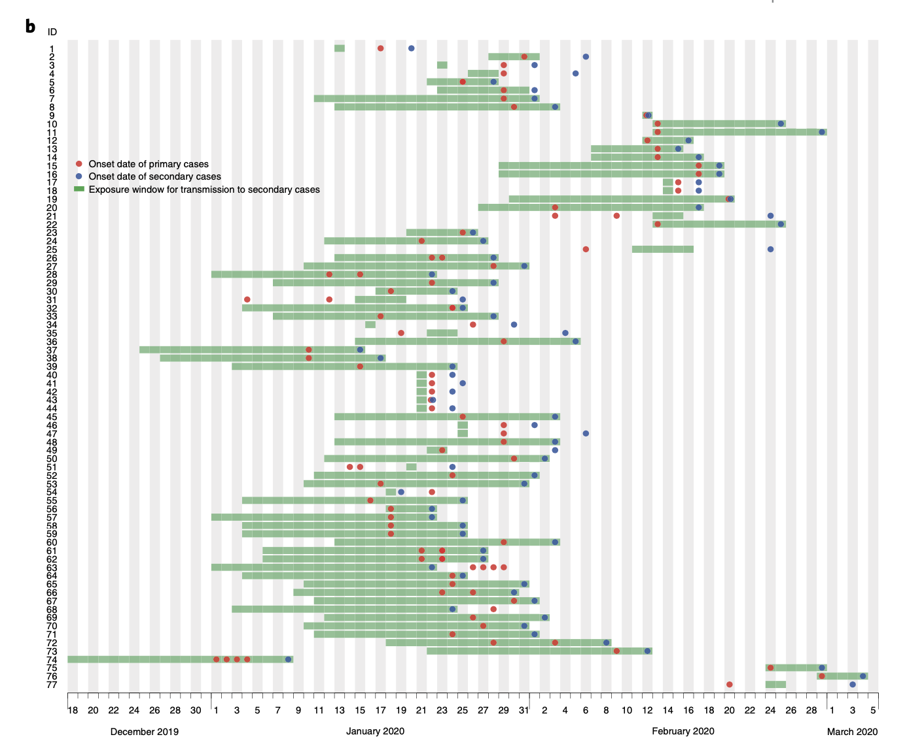
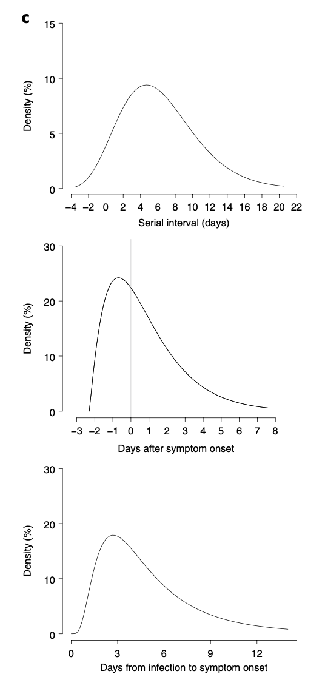
Serial interval
Transmission distribution
Incubation period

Slide 24
Estimates
Serial interval mean: 5.8 days
Infectiousness began 2.3 days before symptom onset and peaks 0.7 days before symptom onset
Infectiousness declined quickly within 7 days
44% of transmission in pre-symptomatic period

Slide 25
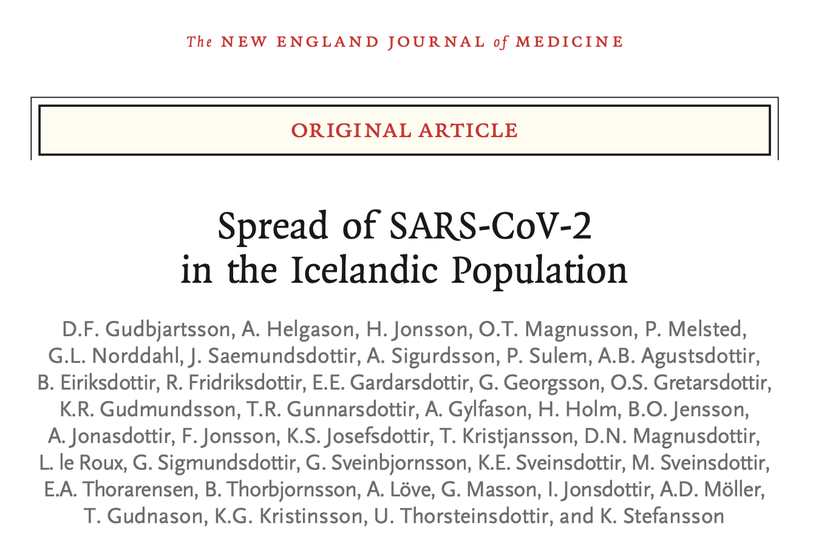
Population-based screening
43% of PCR+, confirmed Covid-19 cases were asymptomatic

Slide 26
SEIR Models

Slide 27
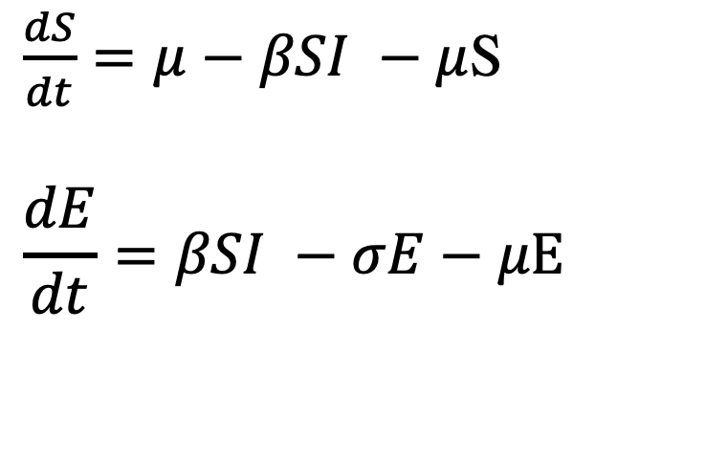
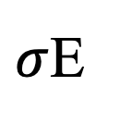
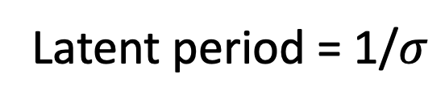
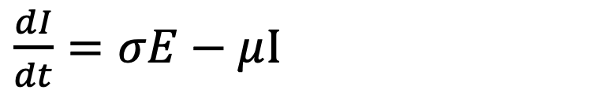
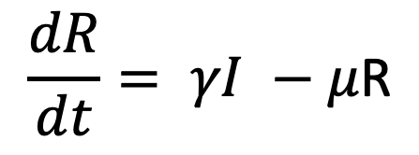
The SEIR Model
S
βSI
E
$σ$Ε
I
γΙ
R
Susceptible
Exposed
Infectious
Recovered
$\frac{dS}{dt}=μ−βSI −μ$S
$$\frac{dE}{dt}=βSI −σE−μE$$
Latent period = 1/$σ$
$\frac{dI}{dt}=σE−μ$I
$$\frac{dR}{dt}= γI −μ\text{R}$$

Slide 28

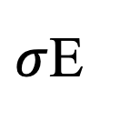
The SEIR Model
S
βSI
E
$σ$Ε
I
γΙ
R
Susceptible
Exposed
Infectious
Recovered
$$R_{0}= \frac{βσ}{(μ+γ)(μ+σ)}$$

Slide 29
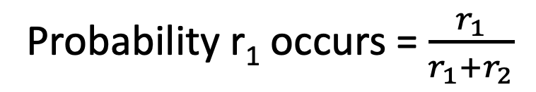

$$R_{0}= \frac{βσ}{(μ+γ)(μ+σ)}$$
Suppose you arrive a train station at a random time.
The A train comes every 15 minutes
The B train comes every 10 minutes.
What is the probability that the A train arrives first?
Competing Risks
X
r₁
r₂
Probability r₁ occurs = $\frac{r_{1}}{r_{1}+r_{2}}$

Slide 30
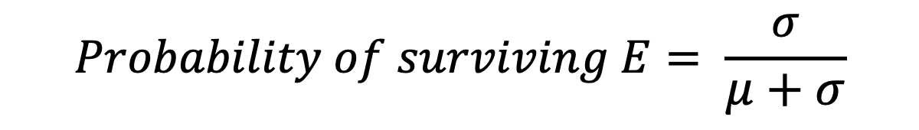
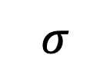
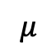
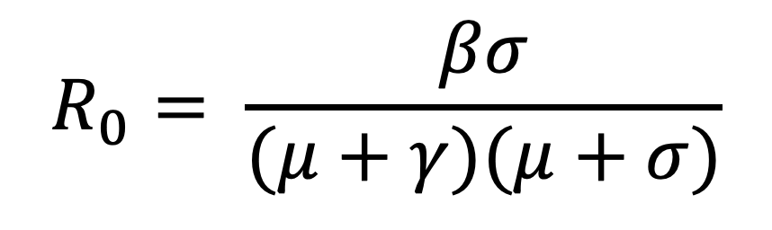
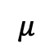
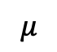
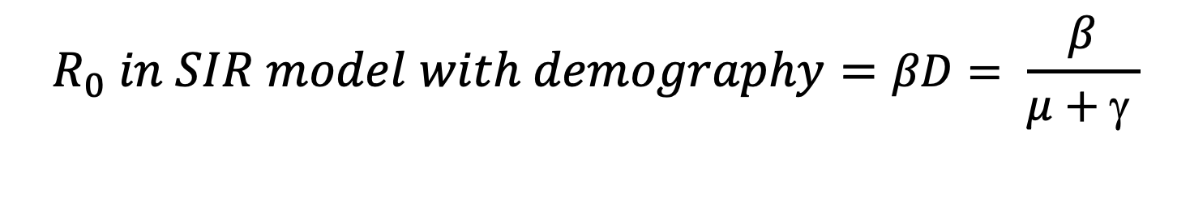
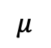
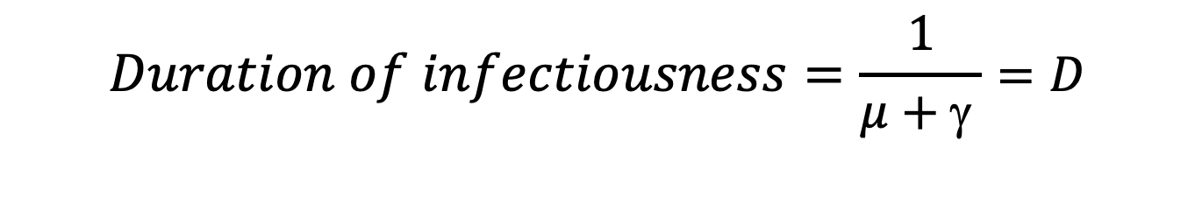
S
βI
E
$$σ$$
I
γ
R
$$μ$$
$$μ$$
$$μ$$
$$μ$$
$$R_{0}= \frac{βσ}{(μ+γ)(μ+σ)}$$
$$Duration of infectiousness=\frac{1}{μ+\text{g} }=D$$
$$R_{0} in SIR model with demography=βD= \frac{β}{μ+\text{g} }$$
$$Probability of surviving E= \frac{σ}{μ+σ}$$

Slide 31
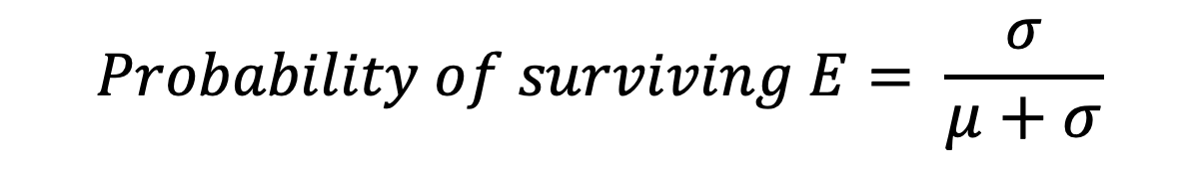
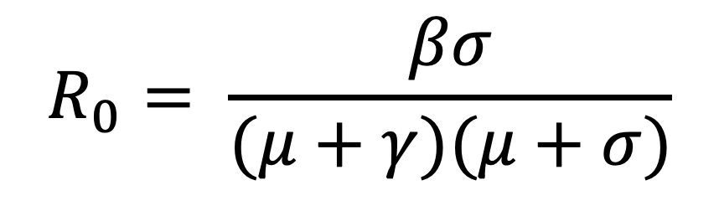
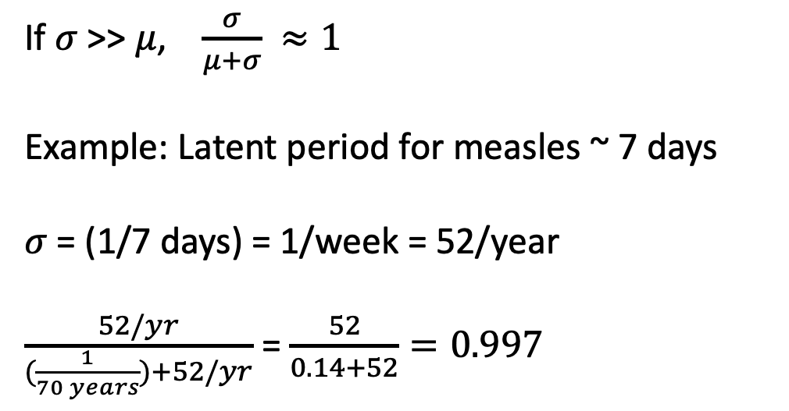
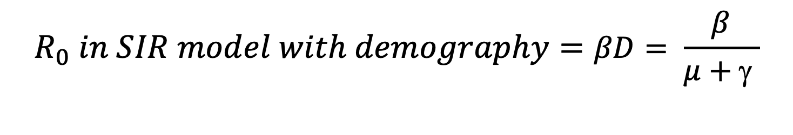
$$R_{0}= \frac{βσ}{(μ+γ)(μ+σ)}$$
$$R_{0} in SIR model with demography=βD= \frac{β}{μ+\text{g} }$$
$$Probability of surviving E= \frac{σ}{μ+σ}$$
If $σ$ >> $μ$, $\frac{σ}{μ+σ} ≈1$
Example: Latent period for measles ~ 7 days
$σ$ = (1/7 days) = 1/week = 52/year
$\frac{52/yr}{(\frac{1}{70 years})+52/yr}$ = $\frac{52}{0.14+52}=0.997$

Slide 32
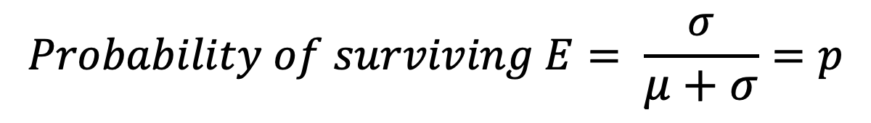
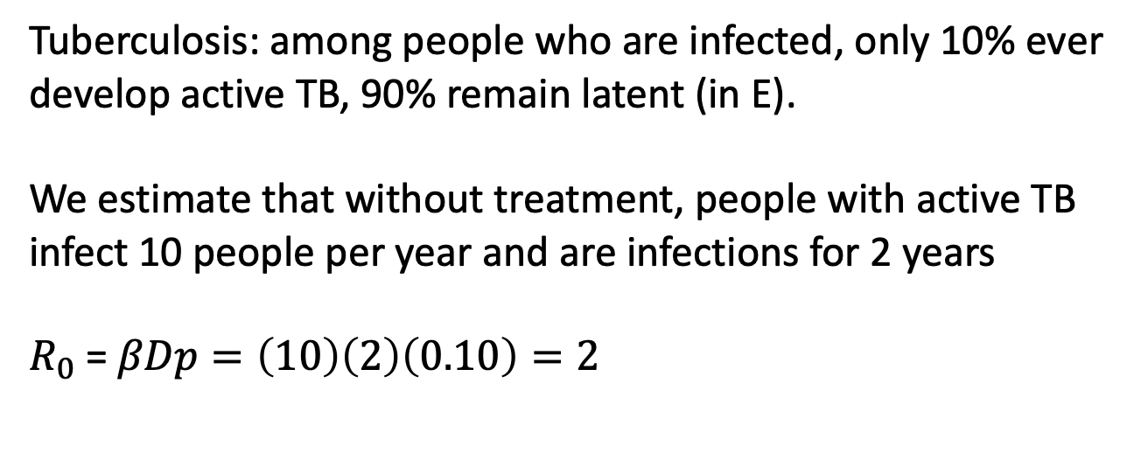
$$R_{0}= \frac{βσ}{(μ+γ)(μ+σ)}$$
$$R_{0} in SIR model with demography=βD= \frac{β}{μ+\text{g} }$$
$$Probability of surviving E= \frac{σ}{μ+σ}=p$$
Tuberculosis: among people who are infected, only 10% ever develop active TB, 90% remain latent (in E).
We estimate that without treatment, people with active TB infect 10 people per year and are infections for 2 years
$R_{0}$ = $βDp=\left(10\right)\left(2\right)\left(0.10\right)=2$

Slide 33
Why use SEIR model?
Long latent period
Interventions
Growth Rate

Slide 34





Interventions targeting latent period
Prophylaxis
S
βI
E
$$σ$$
I
γ
R
$$μ$$
$$μ$$
$$μ$$
$$μ$$
Used widely for TB, HIV, other infections
Under evaluation now for household contacts of Covid-19 patients

Slide 35

How effective do interventions need to be?
$R_{0}$ = $βDp$
$$where p=proportion of latent infections that reach infectious state$$
Suppose for SARS-CoV-2, $R_{0}$ = 2.5. How effective would prophylaxis need to be to avert epidemics?
$R_{0}= βDp=2.5 when p≈1$, so $βD$ $≈$ 2.5
Need $R_{0}$< 1
$βDp$ < 1, so $2.5p<1.$
$p<\frac{1}{2.5}=0.40$.
Need intervention to reduce $p$ by 60%

Slide 36

Modeling Growth Rate More Accurately
SEIR Model with R₀ = 2.5, Latent Period = 4, Infectious Period = 5
50 cases

Slide 37

Modeling Growth Rate More Accurately
SEIR Model with R₀ = 2.5, Latent Period = 4, Infectious Period = 5
SIR Model with R₀ = 2.5, Infectious Period = 5
>8,000 cases

Slide 38


Distribution times in compartmental models

Slide 39

Incubation periods typically follow log-normal distribution

Slide 40


Slide 41

Distribution times in compartmental models
What can be problems with using this distribution?

Slide 42



Distribution times in compartmental models
S
βSI
E
$σ$Ε
I
γΙ
R
Susceptible
Exposed
Infectious
Recovered
n$σ$Ε
n$σ$Ε
S
E₁
E₂
. . .
E_{n}
I
R

Slide 43

SE_{n}IR
n=1
n=10

Slide 44


SEIR Model and Infectiousness
Infectiousness often changes over the course of an illness
S
I₁
I₂
I₃
γ₁Ι₁
γ₂Ι₂
$S(β_{1}I_{1}+$ $β_{2}I_{2}$+ $β_{3}I_{3}$)

Slide 45
What may cause changes in effective contact rate over course of illness?
Burden of pathogens
Symptoms
Contact rates

Slide 46
Concepts Review
Understanding the incubation period and latent period is important for characterizing transmission of infectious diseases; models typically use a latent period unless explicitly modeling symptoms
Exposure times and symptom onset can be used to estimate these entities, but are most tractable with discrete exposures
SEIR models are useful when the latent period is long, epidemic growth rate is of interest, or when modeling interventions during the latent period
Compartmental ODE models have exponential time distributions which rarely reflect realistic intervals; simple modifications can capture these distributions

Slide 47
Survey

Slide 48
Questions?

